Slide 1

It’s All About Thinking, Write?
Council of the Great City Schools
Albuquerque, New Mexico October 29 and 30, 2013
Notes:
----- Meeting Notes (10/29/13 09:09) -----

Slide 2

Presented by the
Vermont Writing Collaborative
Joey Hawkins
joeylornell@gmail.com
Kristin Armstrong
kra888@hotmail.com

Slide 3

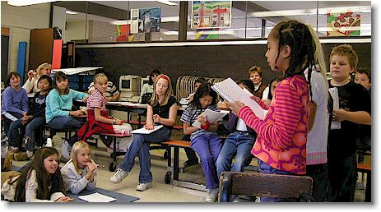


The Big Idea
When teachers
• plan instruction carefully,
• emphasize building understanding, and
• help students to talk about that understanding,
everyone benefits

Slide 4

What are some of the problems and challenges for kids in reading, thinking, and writing about complex text?
Read through these student
pieces
The Longest War (grade 5,
Informative (or opinion?)
My Beautiful World (Grade 7,
Informative)
What may have gotten in the way
for these students?

Slide 5



Common Core Literacy:
What are the key shifts in ELA?
1. Increasingly complex texts
3. Knowledge Base
2. Evidence matters

Slide 6

Common Core Writing Standards
WCCR.1 Argument / opinion
WCCR.2 Informative / explanatory
WCCR.3 Narrative

Slide 7
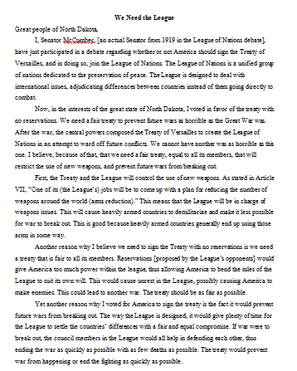
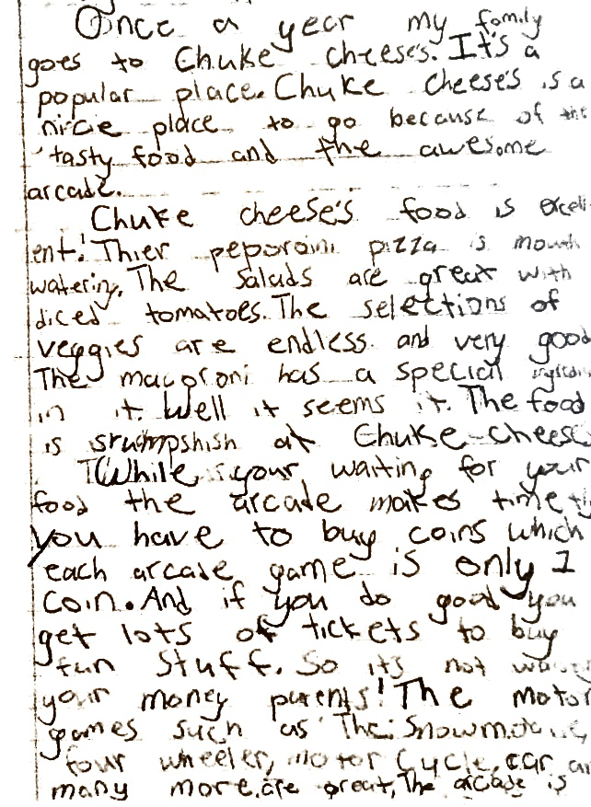
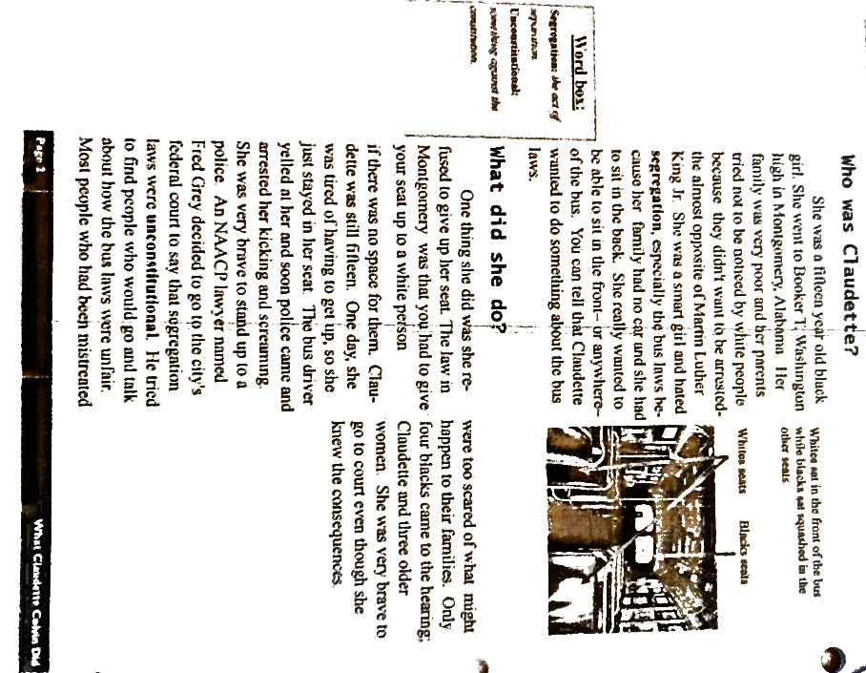
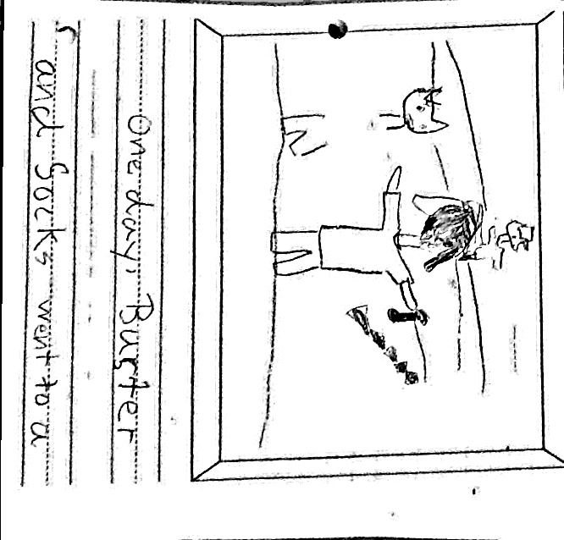
What can a writing progression look like?
Read the writing standards with a partner
What stays the same across the standard?
What changes?
Notes:
Mark up the standards in a way that works for you

Slide 8

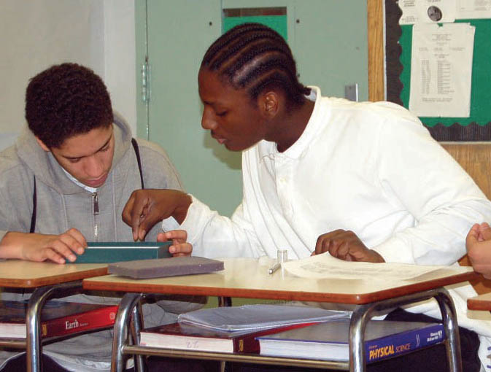
What can strong student Common Core work, written from complex text, look like?
Read these texts, all
written by students in grades 2 – 12
How do they reflect the
Common Core
writing standards?
How can you see deep
understanding and analysis in these pieces?
Notes:
Refer back to the informative writing standards as you read
Remember, this is all about thinking – so pay attention to that in the pieces

Slide 9
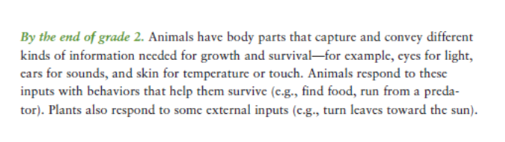
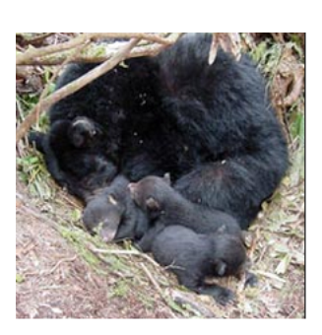
Unit on Seasonal Changes
Focus on how animals survive in winter

Slide 10
Backwards Planning: UbD
Keeping the End in Mind
By the end of the sequence, what does the teacher want kids to know and understand?
BIG IDEA / Central Idea / Enduring Understanding
Animals have certain behaviors that help them survive. Hibernation is one of these.

Slide 11



Focusing Question and
Focus Statement
?
Focusing Question
Focus Statement
How do animals survive in winter?
Some animals hibernate in winter.

Slide 12


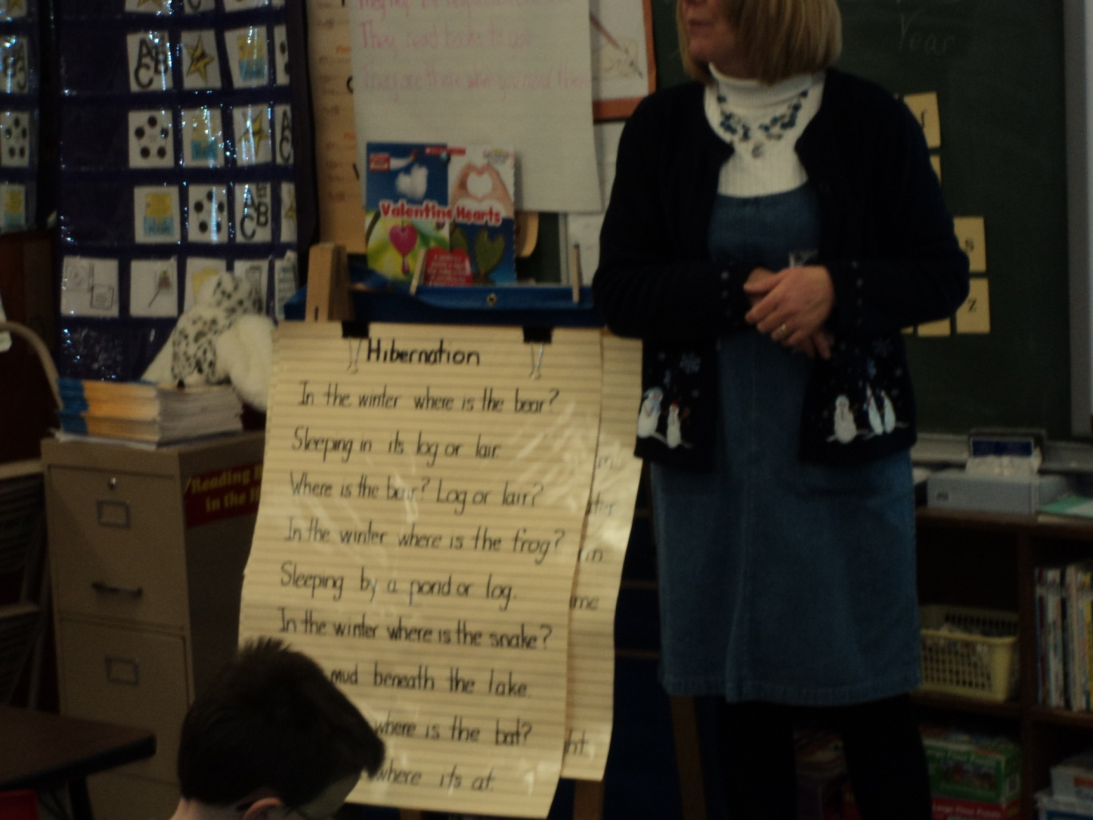
Close Reading

Slide 13
Drawing Students Back Into the Text
"Let's look for that in this picture."
"Does anyone remember what word the
author used to tell us …?"
"Let me see if I can find that part so we can read it again."
"How do you know?"
"Where did you see that?"
"Help me find that part in the book."

Slide 14
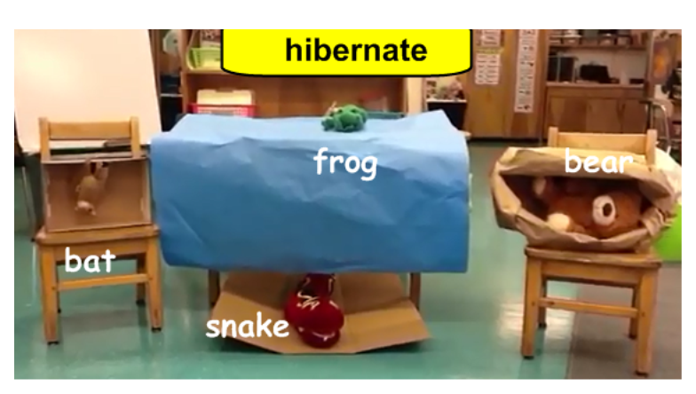
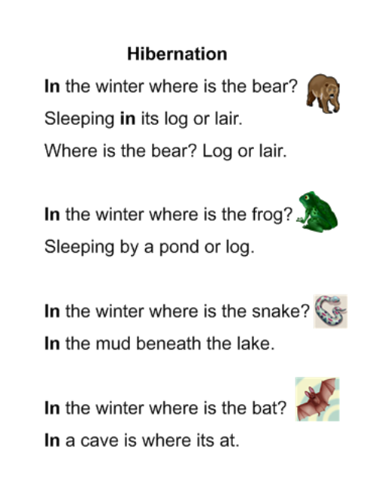

Evidence Matters
How do animals
survive in winter?
Evidence What the animals do to survive in winter. | Elaboration Where do the animals hibernate?
Bears Hibernate | log or a lair
Snakes hibernate | mud
Frogs hibernate | by a pond
Bats hibernate | caves

Slide 15
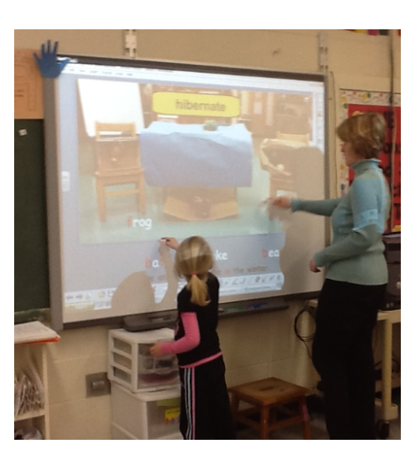
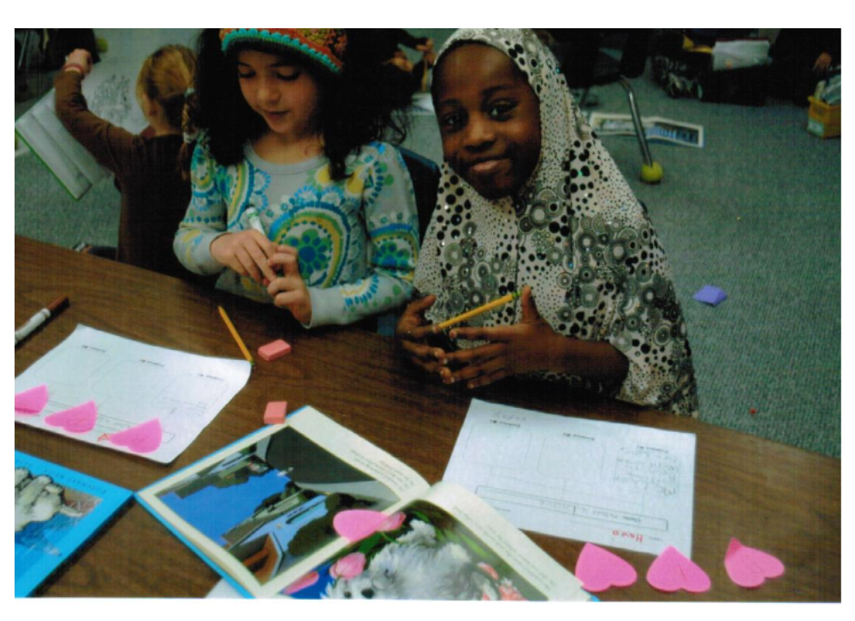
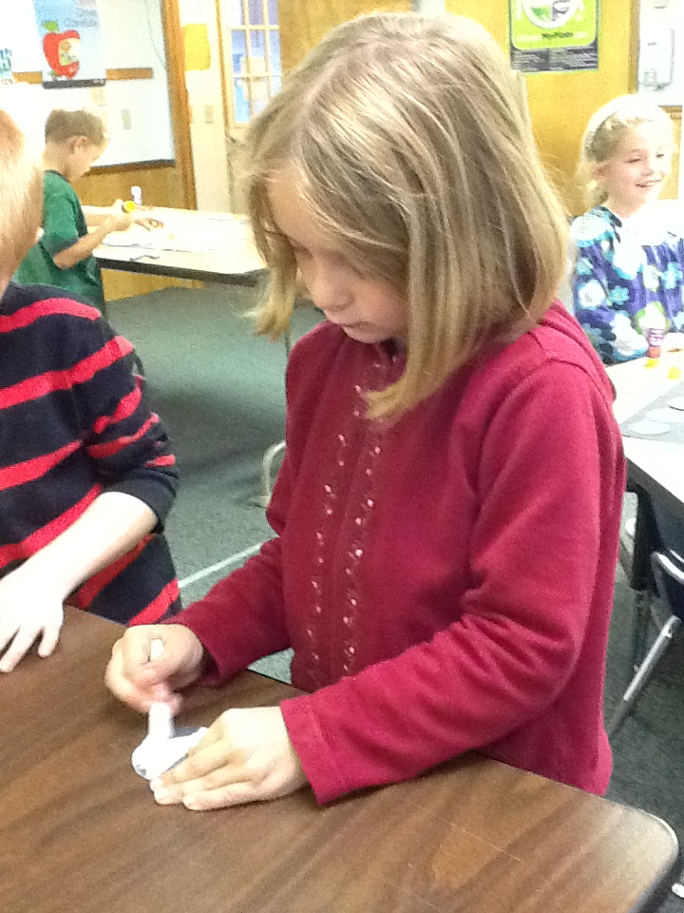
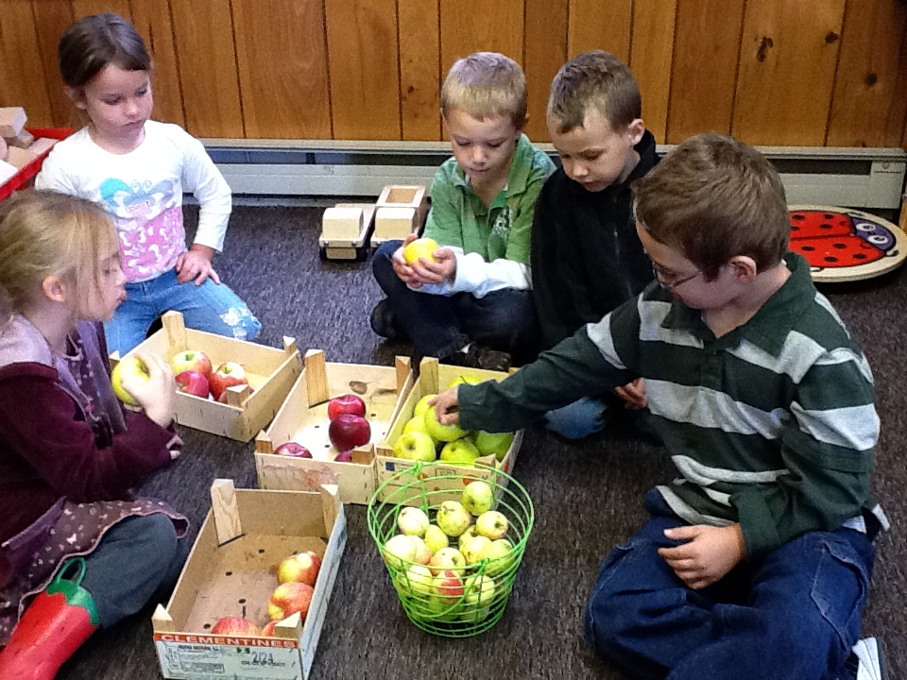

Many Ways to Take Notes
Notes:
Kristin hop in and connect to ELL

Slide 16
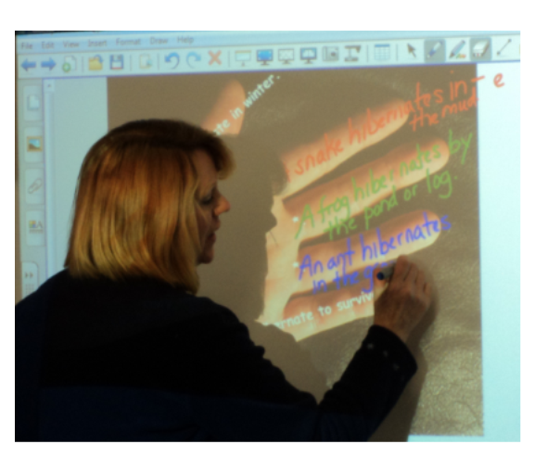
Group Write

Slide 17
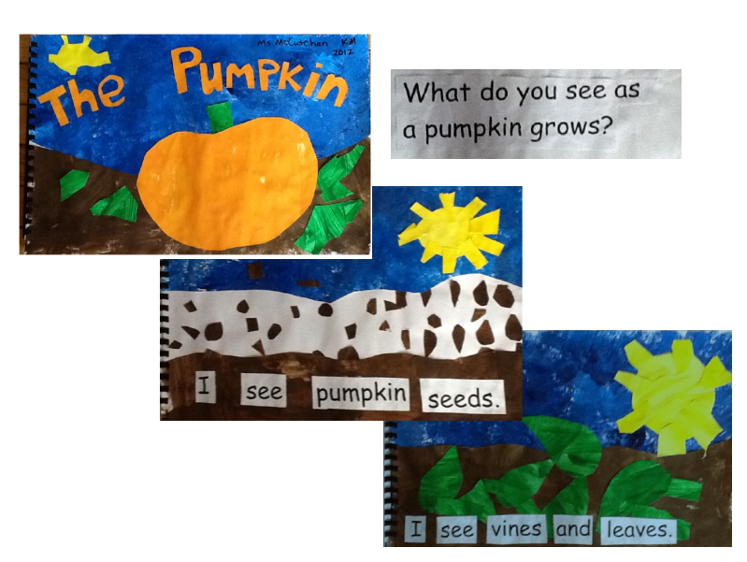
Big Books!

Slide 18
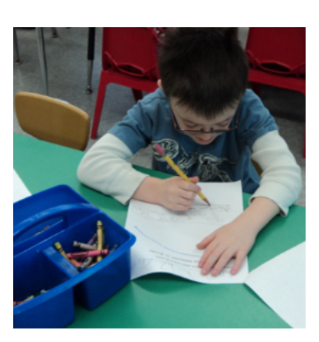
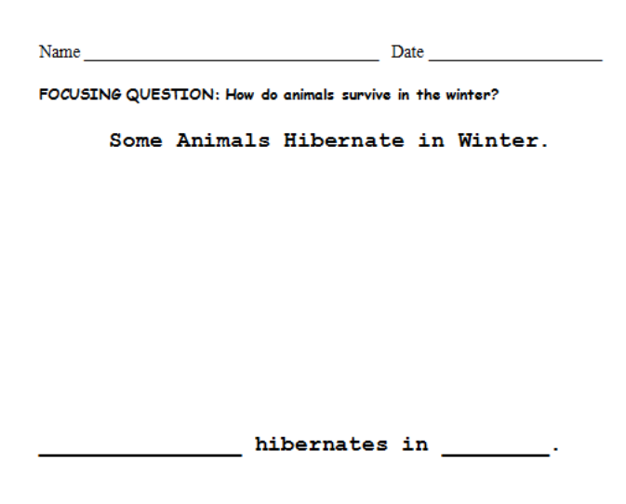
Individual Write
Scaffolded
“Chunked”
Elaboration in pictures

Slide 19
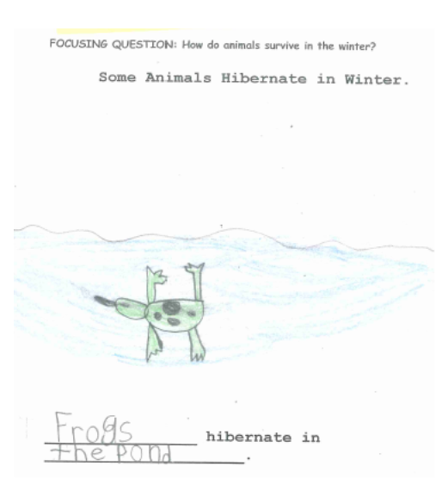
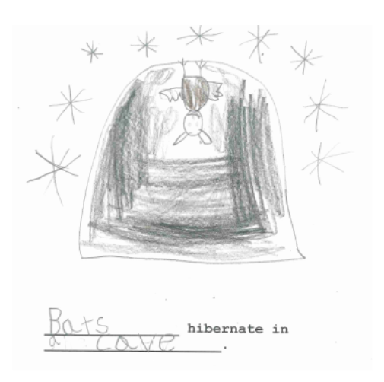
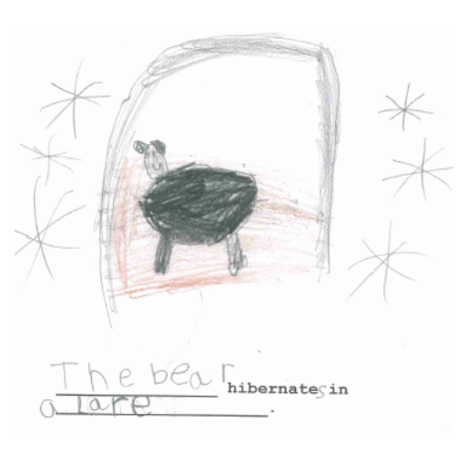
Student work
8. With guidance and support from adults,
recall information from experiences or gather information from provided sources to answer a question.
2. Use a combination of drawing, dictating, and
writing to compose informative/explanatory
texts in which they name what they are writing about and supply some information about the topic.
Notes:
Stop and discuss what you notice about
How the shifts were reflected here
2) How students were guided to think deeply and show that thinking in writing

Slide 20

Guided Close Reading:
Crafting sets of text dependent questions
that deepen understanding and develop
skill in Close Reading.

Slide 21

Begin with a complex text and a “Big Idea”…
Enduring Understanding:
Patterns in the appearance of the moon in the sky can be observed, described, and predicted.
FOCUSING QUESTION:
When you look at the moon, how does the shape seem to change over time?

Slide 22
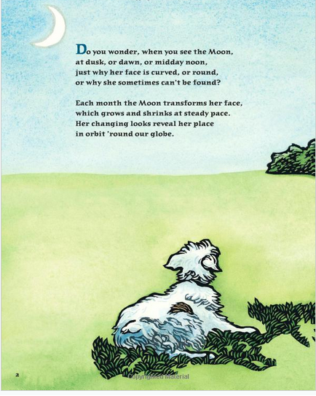
Close your eyes and listen as your teacher reads the poem aloud. Then your teacher will guide you in carefully rereading and discussing each stanza in order to answer our focusing question.
Read…
multiple times!
Text used with permission from the publisher:
Faces of the Moon
Text copyright 2009 by Bob Crelin
Illustrations copyright 2009 by Leslie Evans
Charlesbridge Publishing, Inc.
85 Main Street
Watertown, MA 02472
(617) 926-0329
www.charlesbridge.com

Slide 23
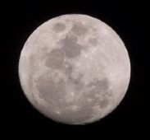
Excerpts from
Faces of the Moon
by Bob Crelin
Do you wonder, when you see the Moon,
at dusk or dawn or midday noon,
just why her face is curved, or round,
or why she sometimes can’t be found?
Each month the Moon transforms her face,
which grows and shrinks at steady pace.
Her changing looks reveal her place
in orbit ‘round our globe.
From night to night and day to day,
she’ll wax (or grow), then fade away.
Each phase has earned a name we say
as light and shadows change.
The Moon’s first phase, we call it NEW-
when Moon’s between the Sun and you.
her sunlit side is turned away,
and we can’t see her, night or day.

Slide 24
A few days pass, and Moon’s less shy;
her smile lights the twilight sky.
The more her sunlit surface shows,
the more Moon’s WAXING CRESCENT grows.
We notice Moon’s FIRST QUARTER phase
around the count of seven days.
Her western half’s so brightly lit-
right down the middle, Moon looks split.
Next comes the Moon’s most famous phase,
around the count of fourteen days.
her monthly orbit’s halfway done,
and now she’s opposite the Sun.
The FULL Moon, big and bright and round,
with not a shadow to be found,
now rules the heavens all night long
and sets upon the break of dawn.

Slide 25
At Moon’s LAST QUARTER of her trip,
her eastern half is brightly lit.
‘Round midnight hour she will rise
to shine amid the morning skies.
From early dawn to morning blue,
her crescent grin is smiling through.
Poised high above the morning dew
is WANING CRESCENT Moon.
Then Moon returns where she’d begun,
to hide between our Earth and Sun,
and though this orbit now is done,
next month she starts anew.
So every time you spot the moon,
at dusk or dawn or midday noon,
you’ll know her by her friendly phase
and watch her change through all your days.

Slide 26
How can I help students navigate the complexities of a text in order to come to a greater understanding of topic or text ?

Slide 27
What Makes Text Complex?
Meaning
Layers of meaning
Structure
Text features
Knowledge
Background
Language
Vocabulary
Purpose
Concept complexity
Genre
Organization
Experiences
Sentence length and structure
Figurative language
Regional/historical usage (dialects)

Slide 28
Types of Text-Dependent Questions
When you're writing a set of questions, consider the following categories:
Questions that support the understanding of meaning.
Questions that support the understanding knowledge of language.
Questions that support the understanding of structure.
Questions that build a knowledge base.

Slide 29
Close Reading
Meaning
Structure
Knowledge
Language
Is this part of the poem like another part of the poem? Which one?
What does the new moon look like? How do you know?
The name “first quarter”moon comes from the fact that the moon is ¼ of the way through its cycle, not because a quarter of the moon is visible. What would be a better name?
What familiar word do you hear in “anew”? What might “anew” mean?

Slide 30
Text-Dependent Questions...
Can only be answered with evidence from the text.
Can be literal (checking for understanding) but must also involve analysis, synthesis, evaluation.
Focus on word, sentence, and paragraph, as well as larger ideas, themes, or events.
Focus on difficult portions of text in order to enhance reading proficiency.
Lead students to a larger understanding and can also include prompts for writing and discussion questions.

Slide 31
A reminder about where we’re headed…
Enduring Understanding:
Patterns in the appearance of the moon in the sky can be observed, described, and predicted.
FOCUSING QUESTION:
When you look at the moon, how does the shape seem to change over time?

Slide 32
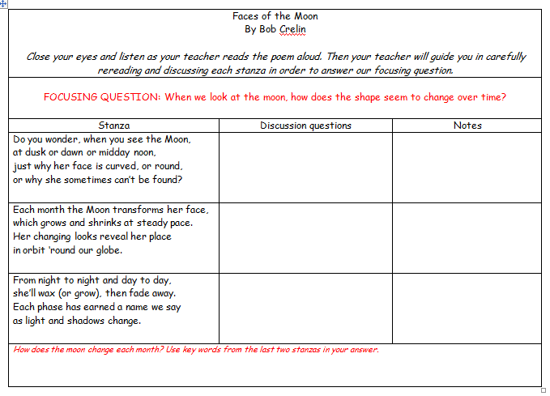
What might guided Close Reading look like?
The author describes three ways the moon can look. What are they?
RI 3.1
What do you think “transforms” means?
What words in the text make you think so?
How does the moon’s face “transform”?
RI 3.4
What does "wax" mean in this sentence? How do you know?
What does the moon do after she “waxes”?
RI3.4
RI 3.1

Slide 33
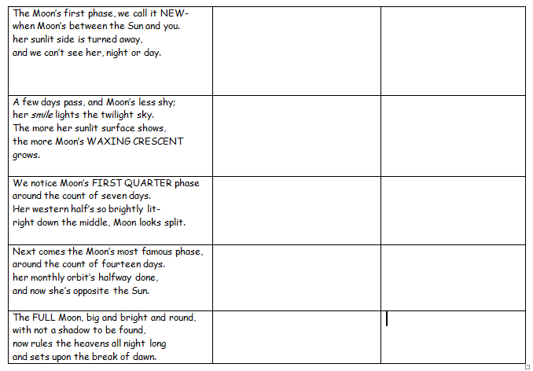
What is the moon's first phase called? Underline the line that tells you.
How would you say that line if you were talking?
Why do you think the author changed the order of the words? L3.1a
What does the new moon look like? How do you know?
Draw a picture of the new moon here.
RI 3.2
What does the author compare the shape of the crescent moon to ? ____________________________________
Why does the author say, "the moon's less shy"? Hint: reread the last stanza !
RL 3.4
Draw a picture of the waxing crescent Moon here.
The name “First Quarter” comes from the fact that the moon is ¼ of the way through its cycle, not because a quarter of the moon is visible. What would be a better name?
L3.4
Draw a picture of the first quarter Moon here.
Look carefully at the last few stanzas you have read. What do you notice about the way this poem is structured?
How can knowing this help you understand the rest of the poem? RL3.5
What is the moon's most famous phase?
What does the “Full Moon” look like?
What words tell you? RL RI 3.1
Draw a picture of the full Moon here.
Notes:
Pay attention to the last column on the right. It’s red, because it’s about meaning.
How will these notes help students show their thinking and understanding in writing?
How is this similar to what the kindergarteners were doing?

Slide 34
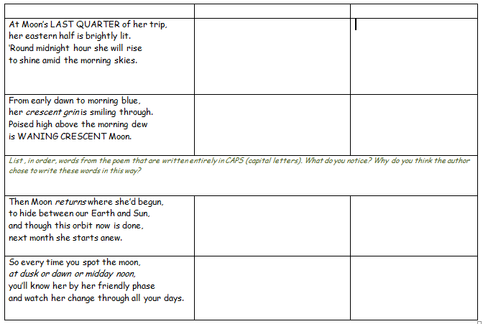
Which half of the moon is lit?
How do you know?
RL RI 3.1
L3.4 A
Draw a picture of the last quarter Moon here.
Draw a picture of the waning crescent Moon here.
Is this part of the poem like another part of the poem? Which one? Shade the stanzas that are alike with your red pencil. RL 3.5
RI 3.1
What words tell us that we will see the same phases again next month?
What familiar word do you hear in “anew”? What might “anew” mean? RI 3.4 L3.4 b, c
Challenge: What phase does the moon return to?
Draw an arrow between this stanza and the stanza that shows how the moon will look next. RI3.5
Where have you seen this phrase before? Can you now answer the question the author posed in the first stanza? How did the poem help you do that?
RI 3.5

Slide 35
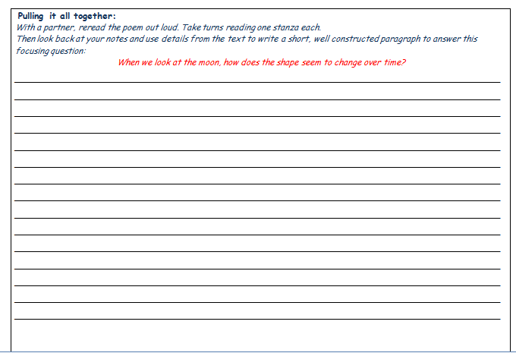
RL RI 3.1 RI 3.2 RI3.3 W 3.2
Notes:
Kristin discuss how this kind of work could help ELL kids, how you might tweak

Slide 36
Guided Close Reading
Step One: | Identify the core understanding students will gain from working with this text and develop a focusing question.
Step Two: | Identify the parts of the text critical to developing that understanding.
Step Three: | What support will students need to understand these sections? Target language, structure, meaning and background knowledge.
Step Four: | Create a coherent sequence of text-dependent questions that guides students in using the text to address the focusing question.
Step Five: | End with a writing assignment, discussion or task that synthesizes the information gained into a core understanding about the text or topic.

Slide 37

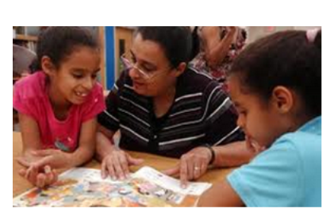

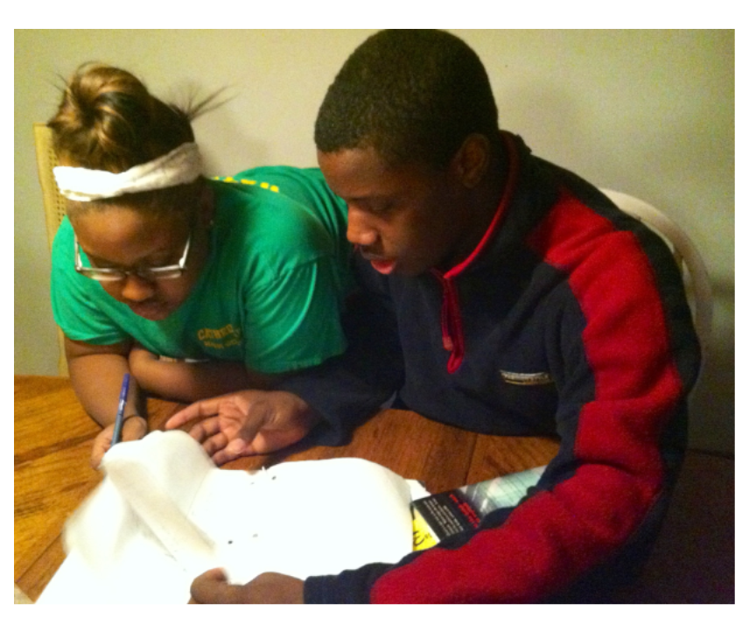
Guided Close Reading:
Backward designed, carefully guided experiences with complex text!

Slide 38
Why Use Guided Close Reading?
Because it provides an opportunity for both
Reading to Learn
and
Learning to Read

Slide 39
Impacting
Human History
Integrating Content with Literacy and the Common Core
in Grades 5-8
Joey Hawkins, Vermont Writing Collaborative
Notes:
Pass out crayons and colored pencils, use with Wangari

Slide 40
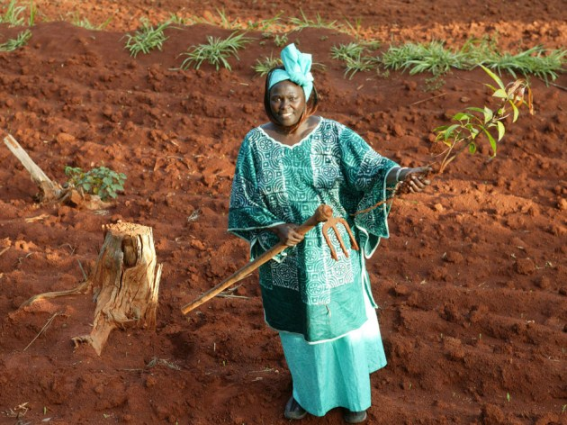
Wangari Maathai and the Green Belt Movement
The texts: “Wangari Maathai, Nobel Peace Prize Laureate, Dies at 71” (New York Times)
Complex text
“Wangari Maathai: Trees for Peace” (Faces)
Less demanding text

Slide 41
Backwards Planning: UbD
Keeping the End in Mind
By the end of the sequence, what does the teacher want kids to know?
BIG IDEA / Central Idea / Enduring Understanding
Wangari Maathai had a big impact on human history. She made Kenya green again, which in turn helped empower poor Kenyan women.

Slide 42
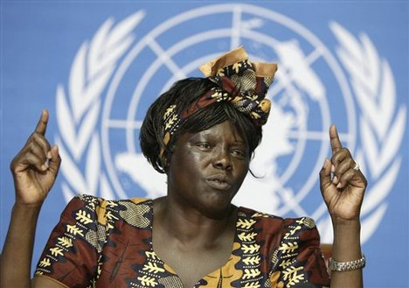
Focusing Question and
Focus Statement
?
Focusing Question
Focus Statement
How has Wangari Maathai affected the lives of poor people in Kenya?
Wangari Maathai’s work helped give poor Kenyans trees again, which in turn has helped empower poor
Kenyan women.
.

Slide 43
Before writing, very close reading!
Remember, the New York Times text is a complex one
As the teacher, I want ALL my students to be able to successfully read and understand this text
Hmmm….how will I do that?
Aha – closely guided close reading!

Slide 44

What can guided close reading look like?
First, students read in their heads while the teacher reads the text aloud.
Next, students work with a partner to re-read and answer the text-dependent questions. Re-read as many times as you need to – this is NOT a test, it is a LEARN!
When students have finished each question, we’ll discuss as a class. (Remember – this is a LEARN..)

Slide 45
What Makes Text Complex?
Meaning
Layers of meaning
Structure
Text features
Knowledge
Background
Language
Vocabulary
Purpose
Concept complexity
Genre
Organization
Experiences
Sentence length and structure
Figurative language
Regional/historical usage (dialects)

Slide 46
Types of Text-Dependent Questions
When you're writing a set of questions, consider the following categories:
Questions that support the understanding of meaning.
Questions that support the understanding knowledge of language.
Questions that support the understanding of structure.
Questions that build a knowledge base.

Slide 47
What Makes Text Complex?
Meaning
In P’s # 7, 8, 9, what evidence does the writer give that Maathai was a “thorn in the side” of Kenya’s president?
Structure
Knowledge
Language
Beginning with P#12, the structure of the article shifts. What kind of information does the author give in P’s #12 – 17?
THINK! How might a movement to plant trees be a part of world peace?
In P#1, what do you think the word “reforest” means?

Slide 48
Wangari Maathai, Nobel Peace Prize Laureate, Dies at 71
1 NAIROBI, Kenya — Wangari Maathai, the Kenyan environmentalist
who began a movement to reforest her country by paying poor women
a few shillings to plant trees and who went on to become the first
African woman to win a Nobel Peace Prize, died here on Sunday. She
was 71.
The cause was cancer, said her organization, the Green Belt
Movement. Kenyan news outlets said that she had been treated for
ovarian cancer in the past year and that she had been in a hospital
for at least a week before she died.
Dr. Maathai, one of the most widely respected women on the
continent, played many roles — environmentalist, feminist, politician,
Professor, rabble-rouser, human rights advocate and head of the Green
Belt Movement, which she founded in 1977. Its mission was to plant
Trees across Kenya to fight erosion and to create firewood for fuel and
jobs for women.
Dr. Maathai was as comfortable in the gritty streets of Nairobi’s
slums or the muddy hillsides of central Kenya as she was hobnobbing
with heads of state. She won the Peace Prize in 2004 for what the Nobel
committee called “her contribution to sustainable development,
democracy and peace.” It was a moment of immense pride in Kenya
and across Africa.
1) How does the title help you understand the coming article?
______________________________________________________________
2) In P#1, what do you think the word “reforest” means?
______________________________________________________________
3) In P#3, what do you think the word “feminist” means?
_______________________________
4) Still in P#3, paraphrase (your own words) what the purpose of Dr. Maathai’s Green Belt Movement is.
________________________________________________________________________________________________________________________________________________________
THINK!! How might a movement to plant trees be a part of world peace?
____________________________________________________________________________________________________________________________
Notes:
Read this page aloud, take people through questions

Slide 49
1) In P#5, why do you think the author tells us how many trees Maathai planted?
______________________________________________________________________
2) In P#6, what do you think the word “ubiquitous” means?
_________________________________________________________________________________________________________
3) In P’s # 7, 8, 9, what evidence does the writer give that Maathai was a “thorn in the side” of Kenya’s president?
Underline the evidence in the text.
THINK!! Why do you think the writer includes all this evidence that you just underlined?
_________________________________________________________________________________________________________
4) What happened to Maathai when she criticized the judge during her divorce case?
___________________________________
What does this tell you about Kenyan human rights?
_________________________________________________________________________________________________________
5 Her Green Belt Movement has planted more than 30 million trees in Africa and has helped nearly 900,000 women, according to the United Nations, while inspiring similar efforts in other African countries.
6 “Wangari Maathai was a force of nature,” said Achim Steiner, the executive director of the United Nations’ environmental program. He likened her to Africa’s ubiquitous acacia trees, “strong in character and able to survive sometimes the harshest of conditions.”
7 Dr. Maathai toured the world, speaking out against environmental degradation and poverty, which she said early on were intimately connected. But she never lost focus on her native Kenya. She was a thorn in the side of Kenya’s previous president, Daniel arap Moi, whose government labeled the Green Belt Movement “subversive” during the 1980s.
8 Mr. Moi was particularly scornful of her leading the charge against a government plan to build a huge skyscraper in one of central Nairobi’s only parks. The proposal was eventually scrapped, though not long afterward, during a protest, Dr. Maathai was beaten unconscious by the police.
When Mr. Moi finally stepped down after 24 years in power, she served as a member of Parliament and as an assistant minister on environmental issues until falling out of favor with Kenya’s new leaders and losing her seat a few years later.
In 2008, after being pushed out of government, she was hit with tear gas by the police during a protest against the excesses of Kenya’s entrenched political class.
10 Home life was not easy, either. Her husband, Mwangi, divorced her, saying she was too strong-minded for a woman, by her account. When she lost her divorce
case and criticized the judge, she was thrown in jail.
Notes:
From here on, color the slides

Slide 50
What Makes Text Complex?
Meaning
Layers of meaning
Structure
Text features
Knowledge
Background
Language
Vocabulary
Purpose
Concept complexity
Genre
Organization
Experiences
Sentence length and structure
Figurative language
Regional/historical usage (dialects)

Slide 51
Up until now in the article, what kind of information has the author focused on?
___________________________
________________________________________________________________________________
2) Beginning with P#12, the structure of the article shifts. What kind of information does the author give in P’s #12 – 17?
____________________________________________________________________________________________________________
In P#16, what do you think a “holistic approach” might mean?
____________________________________________________________________________________________________________
11 Wangari Maathai was known to speak truth to power,” said John Githongo, an anticorruption campaigner in Kenya who was forced into exile for years for his own outspoken views. “She blazed a trail in whatever she did, whether it was in the environment, politics, whatever.”
12 Wangari Muta Maathai was born on April 1, 1940, in Nyeri, Kenya, in the foothills of Mount Kenya. A star student, she won a scholarship to study biology at Mount St. Scholastica College in Atchison, Kan., receiving a degree in 1964. She earned a master of science degree from the University of Pittsburgh.
13 She went on to obtain a doctorate in veterinary anatomy at the University of Nairobi, becoming the first woman in East or Central Africa to hold such a degree, according to the Nobel Prize Web site. She also taught at the university as an associate professor and was chairwoman of its veterinary anatomy department in the 1970s.
14 A day before she was scheduled to receive the Nobel, Dr. Maathai was forced to respond to a report in The East African Standard, a daily newspaper in Nairobi, that she had likened AIDS to a “biological weapon,” telling participants in an AIDS workshop in Nyeri that the disease was “a tool” to control Africans “designed by some evil-minded scientists.”
15 She said her comments had been taken out of context. “It is therefore critical for me to state that I neither say nor believe that the virus was developed by white people or white powers in order to destroy the African people,” she said in a statement released by the Nobel committee. “Such views are wicked and destructive.”
16 In presenting her with the Peace Prize, the Nobel committee hailed her for taking “a holistic approach to sustainable development that embraces democracy, human rights and women’s rights in particular” and for serving “as inspiration for many in the fight for democratic rights.”
17 Dr. Maathai received many honorary degrees, including an honorary doctorate from the University of Pittsburgh in 2006, as well as numerous awards, including the French Legion of Honor and Japan’s Grand Cordon

Slide 52
1) What kind of information is in P#18?
______________________________________________________________________________
Why does the writer include P#18?
______________________________________________________________________________
2) In P# 19, why do you think the author includes a quote from Al Gore?
_____________________________________________________________________________________________________________________
3) Paraphrase Wangari Maathai’s final quote in P# 21.
_____________________________________________________________________________________________________________________
_____________________________________________________________________________________________________________________
THINK!! Why do you think the author closes with this quote?
_______________________________
_______________________________
of the Order of the Rising Sun. She was the author of several books, including “Unbowed: A Memoir,” published in 2006.
She is survived by three children, Waweru, Wanjira and Muta, and a granddaughter, according to the Green Belt Movement.
Former Vice President Al Gore, a fellow Peace Prize recipient for his environmental work, said in a statement, “Wangari overcame incredible obstacles to devote her life to service — service to her children, to her constituents, to the women, and indeed all the people of Kenya — and to the world as a whole.”
20 In her Nobel Prize acceptance speech, Dr. Maathai said the inspiration for
her work came from growing up in rural Kenya. She reminisced about a stream running next to her home — a stream that has since dried up — and drinking fresh, clear water.
“In the course of history, there comes a time when humanity is called to
shift to a new level of consciousness,” she said, “to reach a higher moral ground. A time when we have to shed our fear and give hope to each
other. That time is now.”

Slide 53
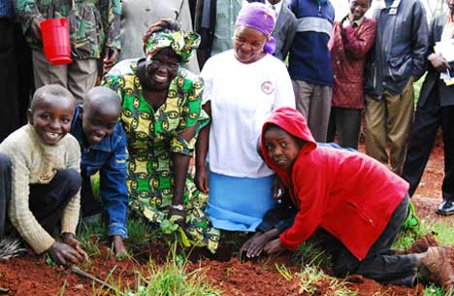
Notes Matter!!
If students are going to write precisely and knowledgably, they need a way to “capture their knowledge”
A simple T-chart organizer – with lots and lots of talking – can be a huge help

Slide 54
Focusing Question: How has Wangari Maathai affected the lives of poor people in Kenya?
Focus Statement / thesis: Wangari Maathai’s work helped give poor Kenyans trees again, which in turn has empowered poor Kenyan women.
Evidence from text – trees | Evidence from text: empowers Kenyan women
This is important because….. | This is important because……

Slide 55
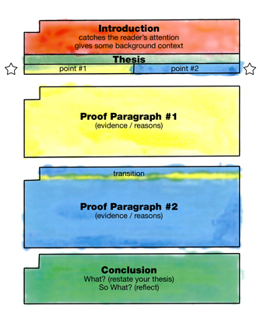

The Painted Essay
A tool for helping students to understand the relationship between purpose, organization and elaboration of evidence in expository writing.

Slide 56
Planning for Structure: the Painted Essay
Introduction: sets context, gives title and author , hook
Focus / thesis: main point writer is making about the text
Point #1 of focus
Point #2 of focus
Evidence from text and writer’s thinking to support focus point #1
Evidence from text and writer’s thinking to support focus point #2
Conclusion: restate, “So what?’
Notes:
Now go back and re=read the student Wangari essay – follows the painted essay, which has helped the student think more clearly – and it’s all about thinking, write?

Slide 57
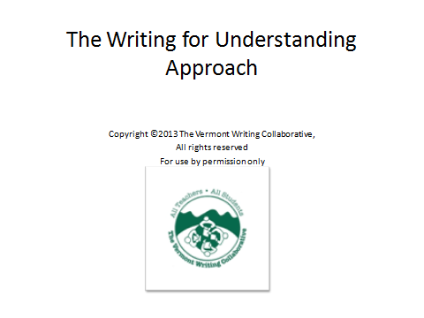
It’s All About Thinking, Write?
Day One
Copyright © 2013 Joey Hawkins, Vermont Writing Collaborative
All rights reserved
For use by permission only

